Slide 1
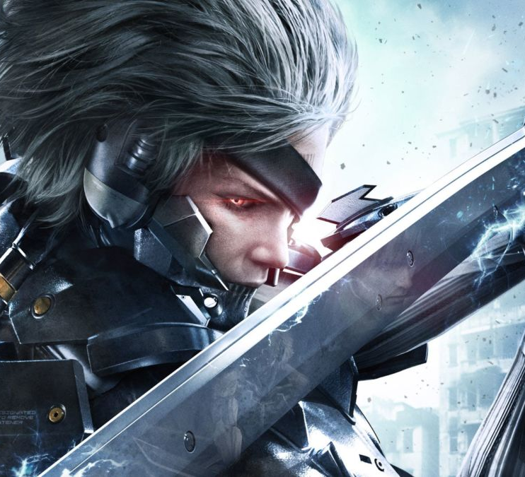
How to make a Hack and Slash with basic combos
Jacob Fernandez

Slide 2
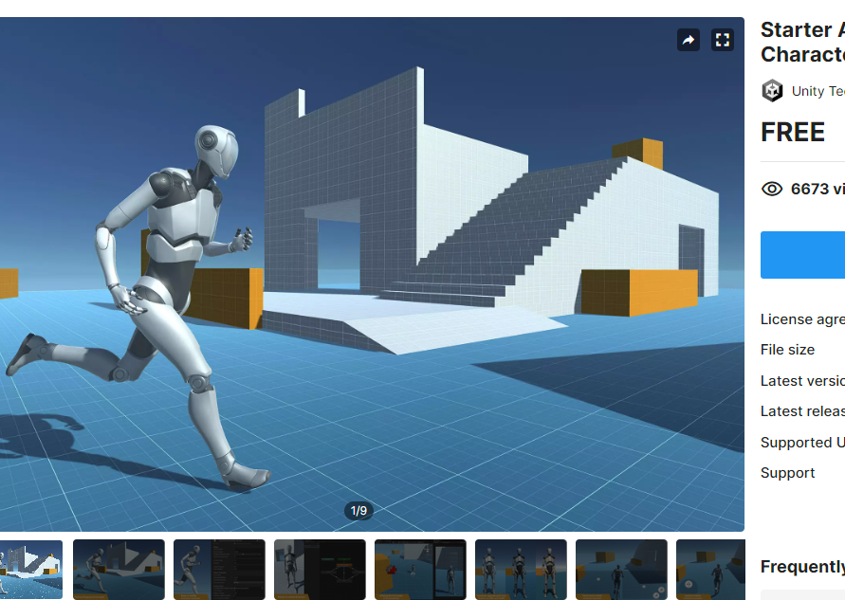
Step 1
Have a character with a character controller of your choosing imported into your unity scene.

Slide 3
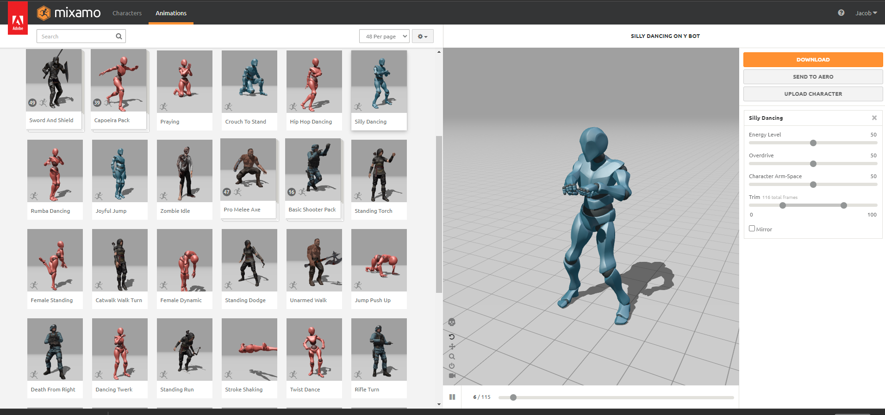
Step 2
Mixamo is always a good source for animations
Get some animations that you would like to use for your attacks/combos

Slide 4
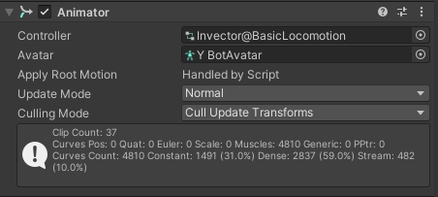
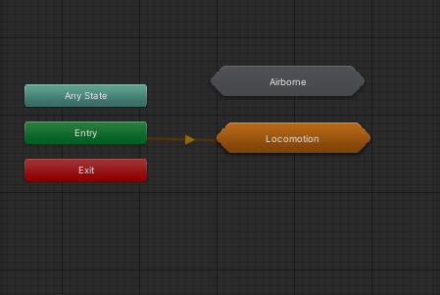
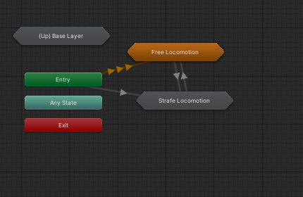
Open the character animator that the controller is using and see where everything is.

Slide 5
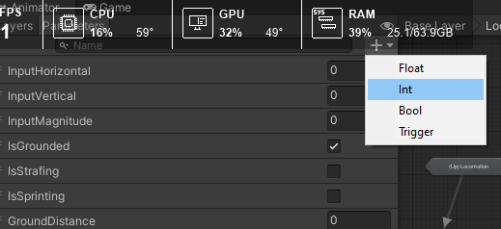
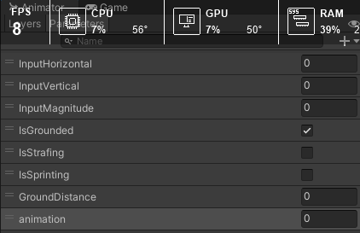
Now we are going to create a int trigger to call these animations by numbers 1,2,3 any order you want

Slide 6
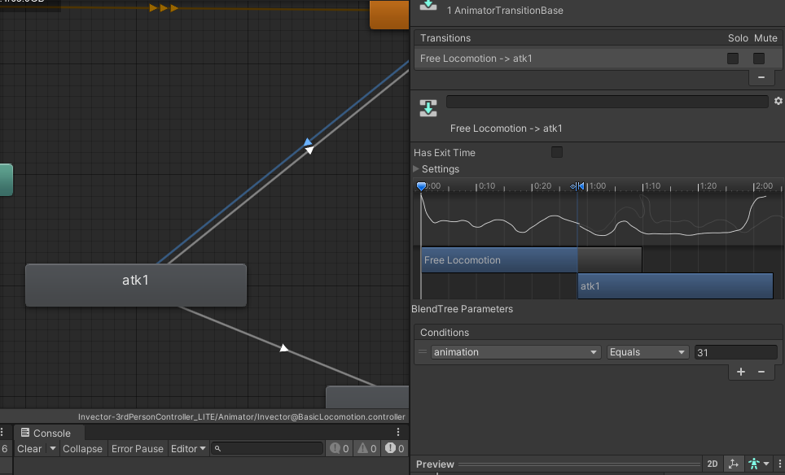
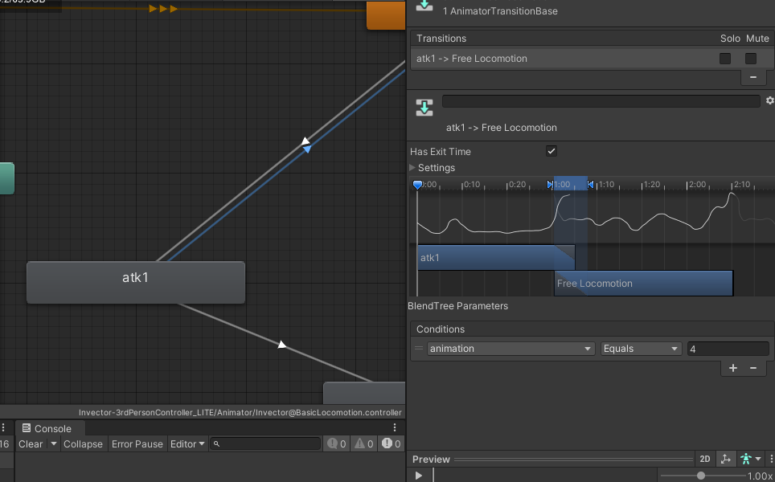
Next we are going to import the animations we downloaded and assign ints to each animation to call later. Make sure to make each animation also have a return animaton value to go back to idle

Slide 7
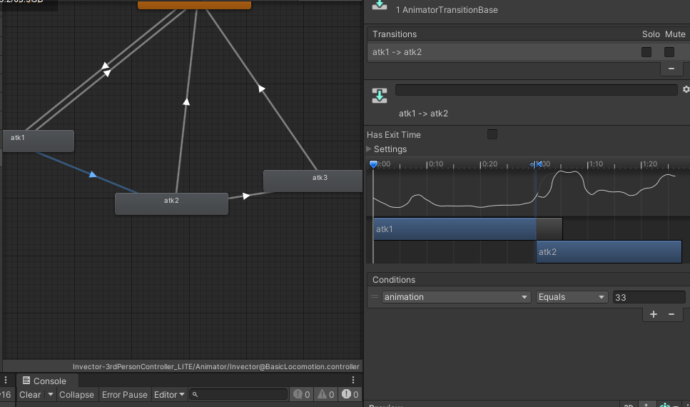
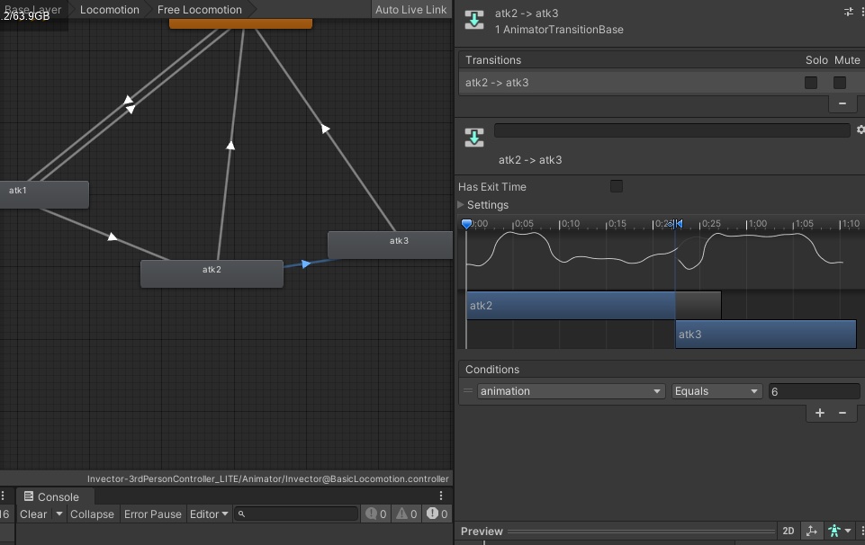


Remember to have each animation return to idle…

Slide 8
Now lets get ready to code how these will link to each other

Slide 9
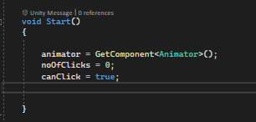
-create a bool that is named CanClick -Create an int that is named noOfClicks
Now lets go to the Start and call these in

Slide 10
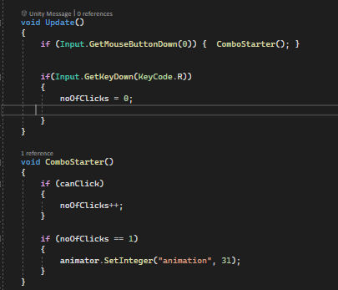
-Next lets write this down This will determine the amount of clicks that are being processed In order for the next animation to play or cancel. -Make sure to set the integer to the number you put as your animation starter in my case its 31

Slide 11
-Next lets write this down This will determine the amount of clicks that are being processed In order for the next animation to play or cancel. -Make sure to set the integer to the number you put as your animation starter in my case its 31

Slide 12
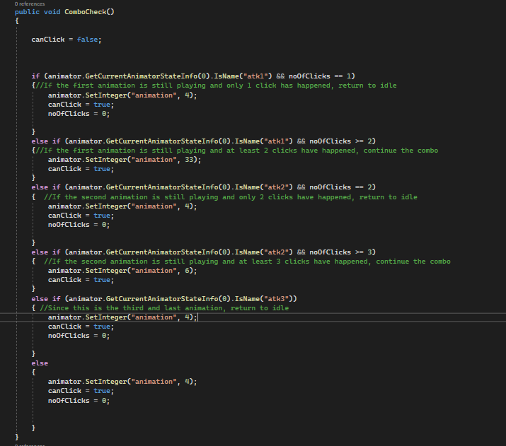
-This is our code that will determine when an animation can be played according to clicks -This is not the most optimal way of doing this, but this will work for this small test project.

Slide 13
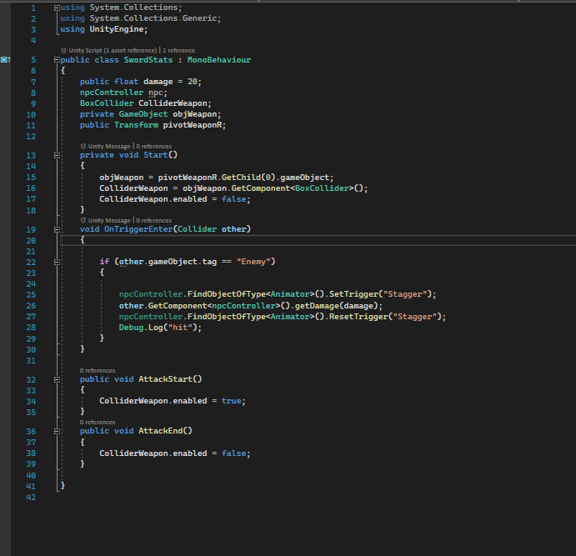
-Now lets make a quick script for the weapon we are using to deal damage to another object or player -We will also be making Attack Start and End functions for the collider to spawn and de-spawn according to the events placed on the animation

Slide 14
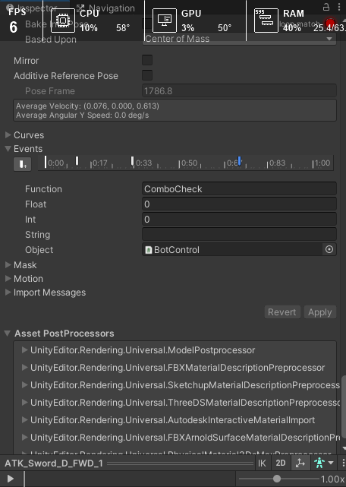
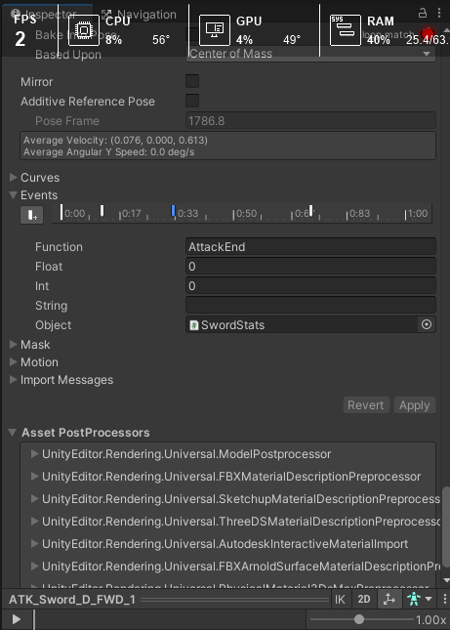
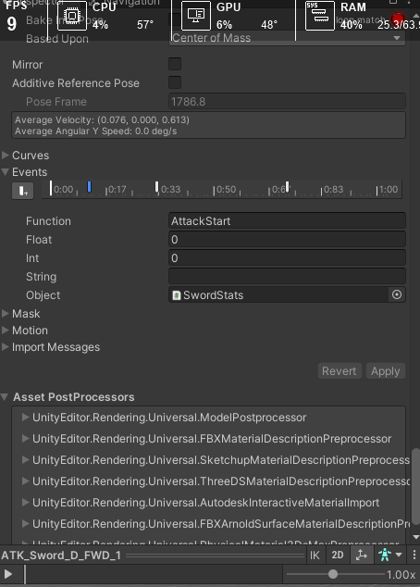

-Now the last thing to do, is to add the events into the animations and we now have us a simple hack and slash with a basic combos.

Slide 15
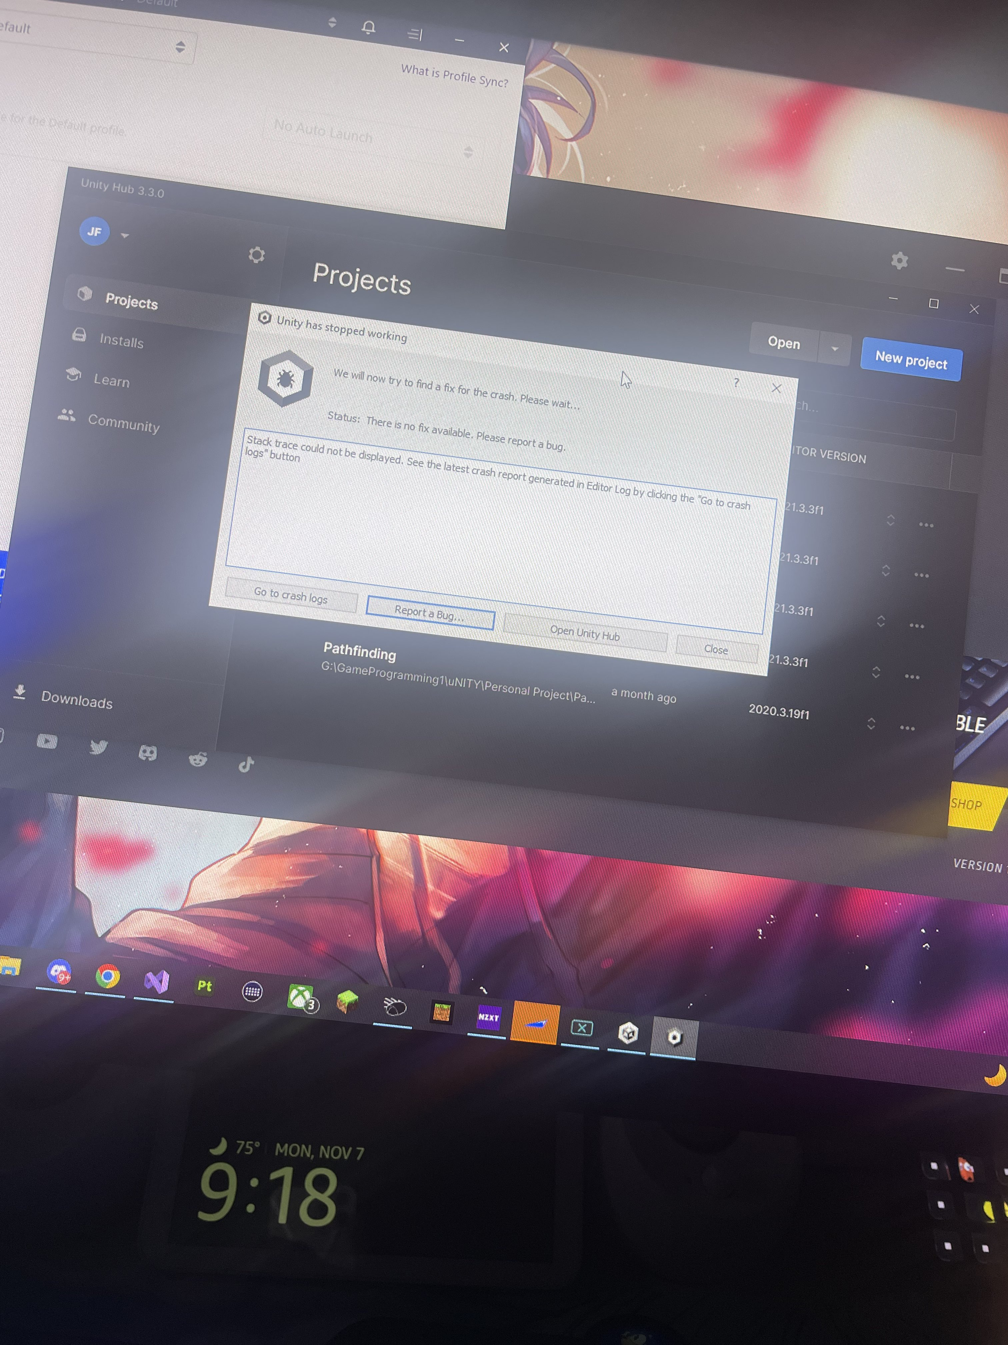
-Lastly always remember to save your projects….

Slide 16
Now lets see the results :D

